Slide 1
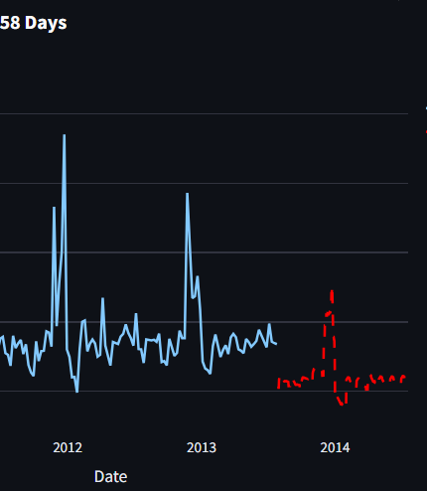
Retail Sales Forecasting
Manas R. Das

Slide 2
Objective
Comprehensive Data Visualization
Key Performance Indicator Monitoring
Advanced Sales Forecasting
Model Interpretability
Dynamic Filtering & Customization
Model Retraining Capability
User-Friendly Interface

Slide 3
Technical Specification
Navigating the future

Slide 4
Technologies & Libraries
Python
Streamlit
Pandas
NumPy
Matplotlib & Seaborn
Plotly
Scikit-learn
XGBoost
SHAP
Joblib
datetime

Slide 5
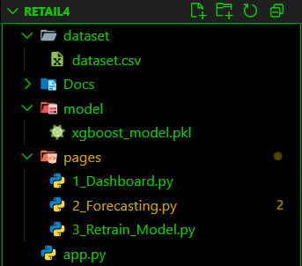
Project Architecture
Unlocking new horizons

Slide 6
Multi-pager Architecture
Dashboarding For Data-Visualization
Forecasting of Day-wise Total & Individual Future Sales
Retraining of Model using new-external-dataset
app.py
Dashboard
Pages/Directories
Forecasting
.
Retrain
.
Entry Point
6

Slide 7
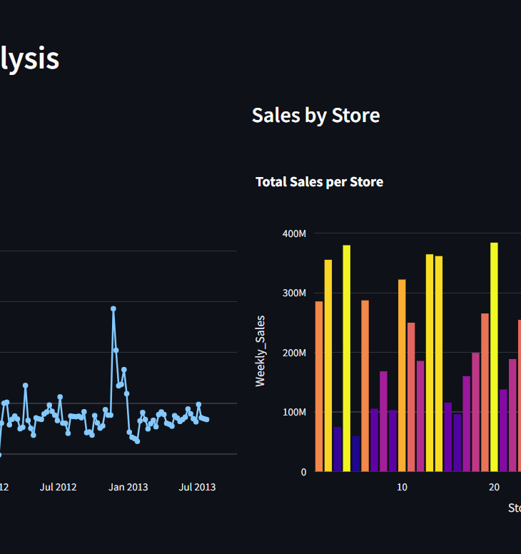
Output
Interactive Dashboard
Key-Performance Indicator
Future-Sales-Forecast Plot
Detailed Future Forecast Table
7

Slide 8
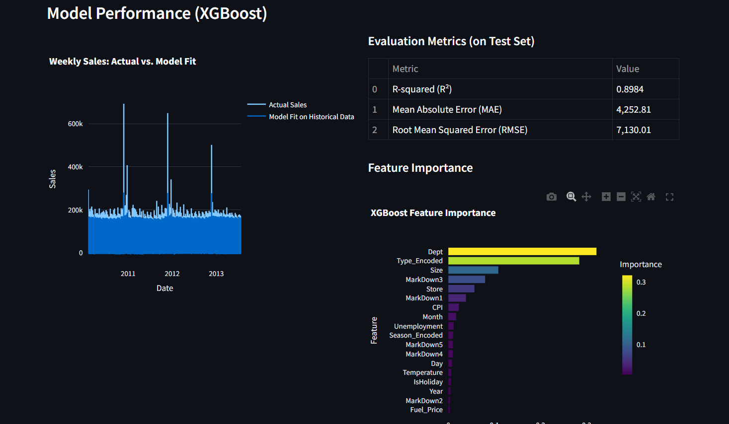
Model Performance

Slide 9
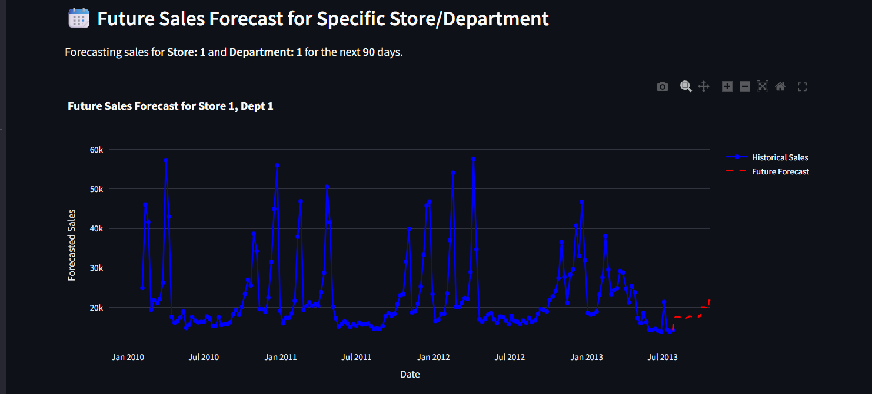
Future Forecast

Slide 10
Outcome
Enhanced Business Intelligence
Improved Forecasting Accuracy
Optimized Inventory Management
Proactive Strategic Planning
Identification of Key Performance Drivers
Continuous Improvements
Democratization of Data Insights
10

Slide 11
Real-life Problem
Solutions
Sales Volatility
Suboptimal Inventory
Inefficient Resource Allocation
Lack of Data-Driven Decision Making
Model Obsolescence
Mitigating Sales Volatility
Optimizing Inventory
Enabling Efficient Resource Allocation
Facilitating Data-Driven Decisions
Ensuring Model Relevance

Slide 12
Future Scopes
More Advanced ML Model
External API Integration
User Authentication & Access Control
Database Integration
Conditional Analysis
Uncertainty Qualification
Automated Retraining & Deployment
Improved Holiday & Markdown Handing
Anomaly Detection
Customizable Dashboards
Scalability for large dataset
12

Slide 13
Thank you
Manas R. Das
dasmanasranjan2005@gmail.com

